Slide 1
AI-assisted-Customer-Complaint-Assesment-Tool
Putting a Generative AI Step Between Complaint Intake and the Work Queue
The problem
A medical device and pharma company receives ~6,000 complaints a year. Every one must be read, classified, graded for potential patient harm and routed to the right team.
That takes ~12 minutes each and is done entirely by hand. Grading harm is a judgement, not a lookup — which is exactly where simple automation fails.
What was built
A working pipeline, not a mock-up. Claude drafts a structured record for each complaint; a qualified handler accepts, edits or rejects it. The AI never closes a complaint.
The same output is built twice — once by Claude, once by a keyword rules engine — so the AI is measured against the cheap alternative, not against nothing.
40
synthetic complaints
assessed end to end
66%
less handling time
12.0 → 4.1 minutes
1 vs 15
serious under-calls
AI vs keyword rules
AI-Assisted Customer Complaint Assessment | Capstone Project Overview
1

Slide 2
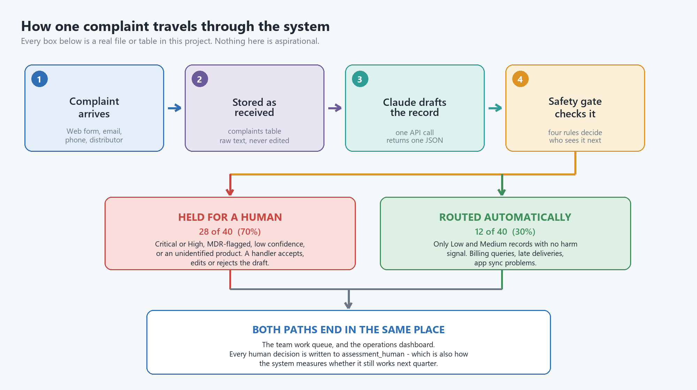
How it works — and where the AI actually earns its place
Every box below is a real file or table in the project. Nothing is aspirational.
Where GenAI adds value
Rules match keywords. The model reads meaning:
• grades harm from narrative
• names the facts that are missing
• resolves nicknames to a catalogue
• turns a complaint into a task
The human review gate
A record is held for a person if ANY of:
• severity is Critical or High
• flagged reportable to a regulator
• model confidence below 0.75
• the product could not be identified
28 of 40 (70%) were held. Nothing touching patient harm is ever auto-routed.
AI-Assisted Customer Complaint Assessment | Capstone Project Overview
2

Slide 3
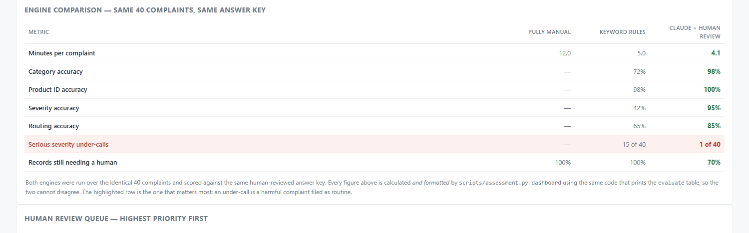
Results, and an honest read of them
Both engines run over the identical 40 complaints, scored against the same human-reviewed answer key.
The finding that matters
The keyword engine graded 15 of 40 harm-related complaints as routine. It has no keyword for “woke gasping” or “returned to theatre”.
Claude got 1 wrong. That gap is the project.
The money is thin
~$33,200/yr of freed time against $34,000 build. Year 1 runs at −$11,400; payback mid-year 2.
Limitations
40 synthetic records; one author wrote the complaints, the answer key and the AI output. Figures are illustrative, not validated.
Recommendation: fund a 90-day shadow pilot, not the build. The efficiency case is thin; the safety case is strong but rests on synthetic data.
AI-Assisted Customer Complaint Assessment | Capstone Project Overview
3

